Slide 1
DEVELOP AN OUTCOME L2
Evidence of Learning Template
NSN: 0137401690
Minesweeper
Madhav Nair

Slide 2
Github /Drive link
Trello board or PM link
You MUST provide evidence showing how the problem has been decomposed, how the components have been developed and trialled, and of how they have been assembled and tested to create a final, working outcome.

Slide 3
Project management: Setup and applied
Record evidence that you have setup project management tools to manage the development of your outcome.
Record evidence that you have chosen project management techniques to manage the development of your outcome.
Record evidence that you have setup/ chosen version control tools/techniques to manage the development of your outcome.
Explain why you believe that these tools and techniques are appropriate for the development of your outcome.
Record evidence that you have used your project management tools to manage the development of your outcome.
Record evidence that you have used your project management techniques to manage the development of your outcome.
Record evidence that you have used version control tools to manage the development of your outcome.

Slide 4
Using Monday.com
I first made a list of the things that i needed to do early on in the process. I wrote up all the minimum requirements I needed to make the game work. My initial planning process consisted of writing down any idea I had for improvements and researching if it was possible for me to complete these ideas before the deadline. I then put these ideas on Monday.com and set myself deadlines to finish them. Monday.com allows me to keep track of my work and update it whenever I finish a task.The deadline feature reminds me through emails when I need to finish my work . This means it was easy to break down my work and plan how to finish it.

Slide 5
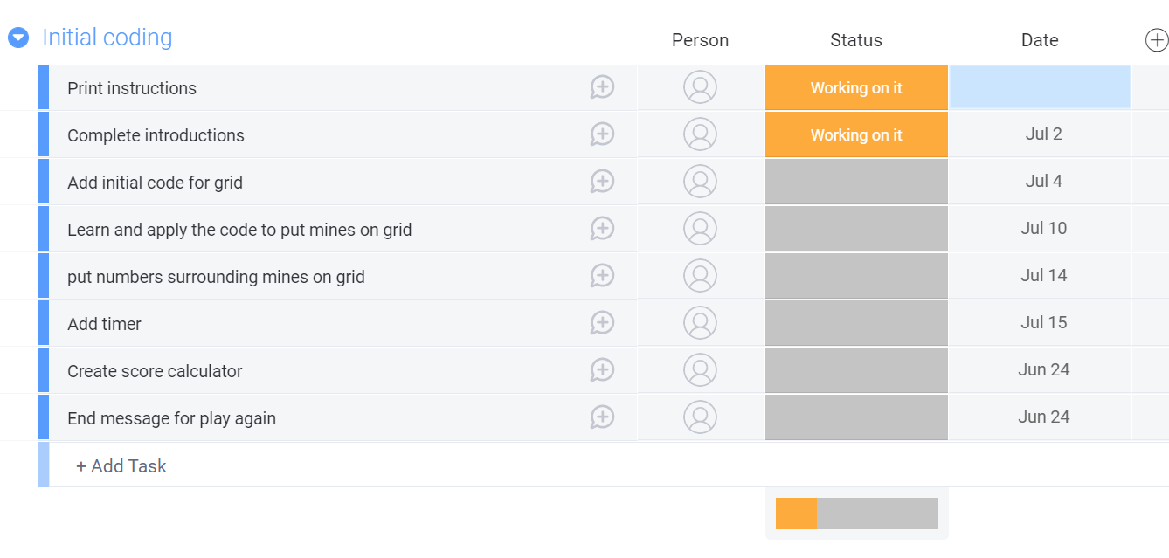
Beginning planning

Slide 6
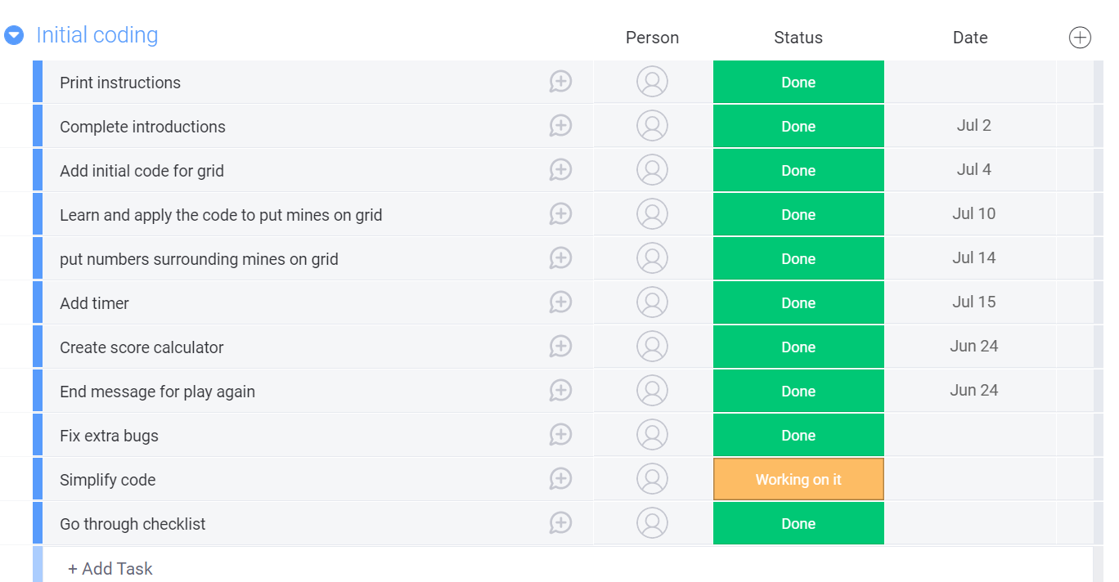
Planning at Week 10

Slide 7
Decomposing outcome
Record evidence that you have broken the outcome into smaller components.
Introduction and instructions
Making grid
Placing Mines
Detecting numbers around mines
Timer
End message and play again
Testing and trialling

Slide 8
Introduction and Instructions
I put in the code that introduces the game and greets the user while also printing instructions on how the game works

Slide 9
Making grids and placing mines
I drew a basic grid using inspiration from the internet as I had no knowledge on how to develop a grid from scratch. I made sure that the grid was clear and the player was able to place a mine wherever they clicked. I also made sure the grid updated whenever a new mine was placed

Slide 10
Detecting number around mines and making timer
This was the hardest system to make. I added 1 square to all the blocks surrounding the mine. Which led to the player to clearly understand how many mines were around the place the player had clicked. There was also a timer function I made so there was replayability. The timer kept counting until the player wins or loses.

Slide 11
End message and play again
The end message informs the player if they have won or not. It also asks the player if they want to play again. It also resets the game if the user has finished and chooses to try again.

Slide 12
Trialling components
Record evidence that you have trialled components. Show that you gathered information to inform your decision making..
Record evidence that you have trialled multiple components and have selected those most suitable.
Record evidence that you have used information from trialling appropriately to improve the functionality of the outcome.

Slide 13
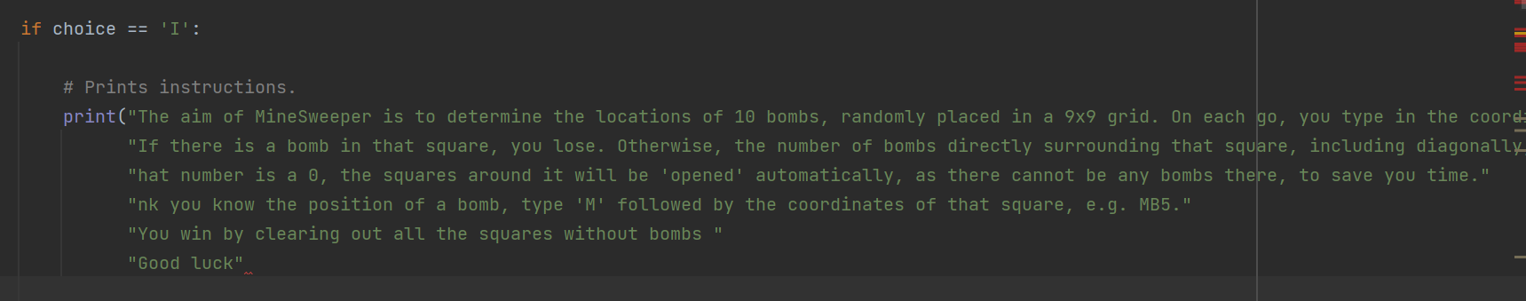
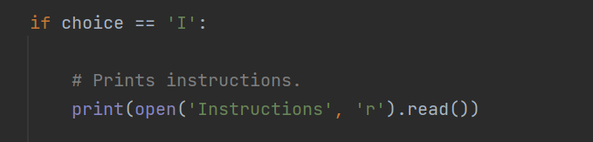
Trial - Choice of instructions
Initially I had it set so that I had wrote out my instructions on my main.py file. This looked messy and the formatting was off so I made a separate text file to write out my instructions for the main.py code to print.
Initial Code Updated code

Slide 14

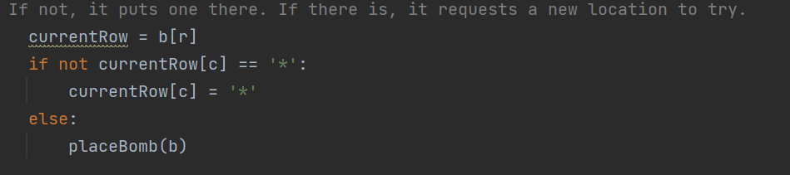
Trial - Bomb stacking
The bombs kept stacking on top of each other when the game started running. This prevented the game from running properly as two mines on the same spot ruins the rules of the game but I found a fix by adding code that detects whether there is a bomb on that spot or not.
Original code
Updated code that prevents mine stacking

Slide 15
Trial- Invalid entry
Previously there was no code that prevented the code from breaking whenever a user answer something other than the intended answers. I fixed this issue by adding a “While True” function that loops the code whenever the user puts an invalid answer, forcing the user to complete the game properly.

Slide 16
Testing outcome
Record evidence that you have tested your outcome.
Explain how the testing made sure your outcome functions as intended to meet its purpose and requirements.
Record evidence that you have used information from testing appropriately to improve the functionality of the outcome.

Slide 17
Self Testing
I have vigorously self tested my code for errors and bugs multiple times throughout the creation of the game and after the game was done. I answered every answer I could think of to check for bugs or game breaking glitches.

Slide 18
Stakeholder Feedback
Asking for feedback is a useful way to see issues you have not noticed before. I showed my feedback to Miles Torrington and he thought I needed to add the feature to write “y” instead of “Yes”, when asked to play again. This was a easy fix I had not thought of before and I needed a users opinion to make sure that the code is as accessible as possible. Stakeholder Feedback is good because it provides a new perspective on your code and lets you view it from the angle of a regular user.

Slide 19
Debugging
I had debugged my code before handing it on to make sure I did not have any errors or mistakes The debugging for me was also very helpful as I learnt a lot more about python itself and how to problem solve. For instance, one thing I learned and then had to change throughout my code was to use Try/Except statements whenever I needed the answer to enter an input because this way it was easy to get it to loop. This was something I had not known before the debugging. The debugging helped my code to be efficient and working.

Slide 20
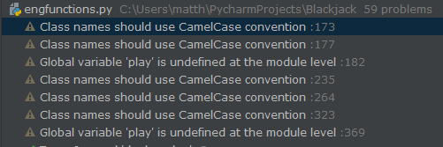

PEP8
The “Python Enhancement Proposal” provides guidelines and the best practices for writing code using the Python language. I used this while simplifying my code as this helps the code to be readable and more clear. This is helpful especially if me or someone else wants to alter the code in the future, as it is going to be very easy to understand how it works if everything is readable and has correct capital letters and spacing.

Slide 21
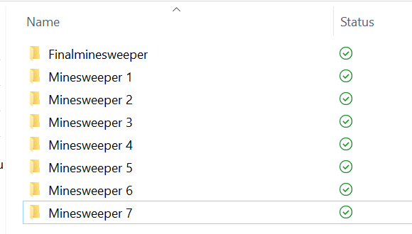
Version Control
I was worried that my code was going to get lost so I made and kept backups on my USB so if my code got lost I still ahd backups. The backups also helped me go back to older versions of the code to see what I did wrong if my code was not working. This is why after every big new addition I made a new version of the code

Slide 22
Relevant Implications
Explain the relevant implications here. Please watch this video to learn how to do this.
Explain the Implications that are relevant to your outcome.
Record evidence that you have addressed the Implications that are relevant to your outcome.

Slide 23
Implication 1: Functionality
Functionality is how easy the code runs without encountering any errors. I think my game is easy to play and understand and there are no bugs to prevent the user from experiencing the entire game. I have spent hours playtesting my code to make sure that there are no errors that prevent the game from working and that everything runs with maximum efficiency. Every line of code for Minesweeper is fine tuned to ensure that all the functions work well and mimic the functions of a professional minesweeper game

Slide 24
Implication 2: Sustainability and Future-Proofing
I made sure everything all the code was sustainable and will be able to compete in the future when the code is changed. I did this by future -proofing the code so that it will be extremely easy to make changes or improvements later on if I feel like I need to update the code to fit the modern landscape.
Minesweeper is a classic game that has not had any major update in the last 50 years but if I were to update it,I have made it very easy to. All my code have been simplified as much as possible to allow me to make adjustments easier. I could also be able to change the grid size and length of the game extremely easy without having to affect any of the other code.

Slide 25
Implication 3: Legal
My code does not break any laws and does not steal any information from the user. Minesweeper is a fictional game that does not have many opportunities for me to break the law by stealing information. The game is also accessible to everyone and does not discriminate based of race,gender or sexuality.

Slide 26
Implication 4: Ethical
My code does break any ethical codes. It does not exploit the user in any way and it is just a simple minesweeper game with the purpose of entertaining the user. There is no betting system and it does not make the user lose money.

Slide 27
Evaluate - Planning
I used Monday.com to plan out all the tasks I needed to complete and to remind myself when I needed to due them. It was very useful as it sent me notifications to remind me when the deadline for a task was coming up and I was able to update the table as I worked on my project to mark off the projects that I have fixed. I think this was the most efficient choice as I remained on track and even managed to complete all my tasks early. It also helped to get a clear idea of what to do before I even started. The guideline was very useful into making sure I managed to not only finish the game, but also be able to make updates to it to maximise the efficiency of the code.

Slide 28
Evaluate - Trialing
To maximise the efficiency of the code, I trailed my code several times to make sure the game was running smoothly and there were no bugs I needed to fix. After each trial I improved on the mistakes I had made in the code until I was unable to notice any mistakes when trialling my code. I made sure to take account functionality, sustainability, future proofing,legality and ethicality when trialing and improving the code. Trialling was important because it taught me more about coding me fix all my mistakes to create the optimal minesweeper game I could make with my knowledge of coding at this level.

Slide 29
Evaluate - Testing
I tested a lot during the coding process and after it. This was so my code would not have any errors. Testing helped not only improve my codes functionality but also its efficiency. I used peer feedback and stakeholder testing to make small changes to my code that improved the user experience. I also did a lot of bug fixing so I did not have any bugs when I submitted my code. I had also used a PEP8 checker to improve the codes readability. Testing my code was very important to the project process as it helped me fix any mistakes I had made and helped me learn more about the coding process.

